Slide 1
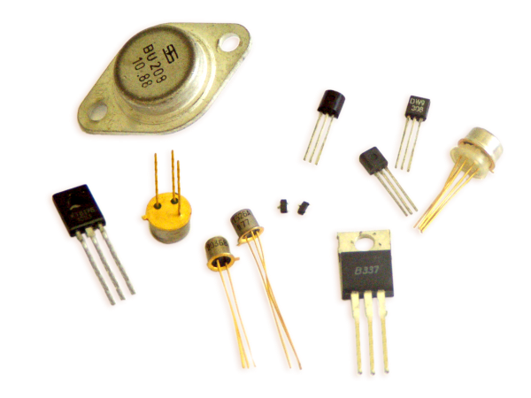
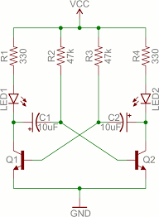
Using, Choosing and Abusing Transistors
Ray Crampton, Feb 2019
Add more practical examples

Slide 2



Slide 3
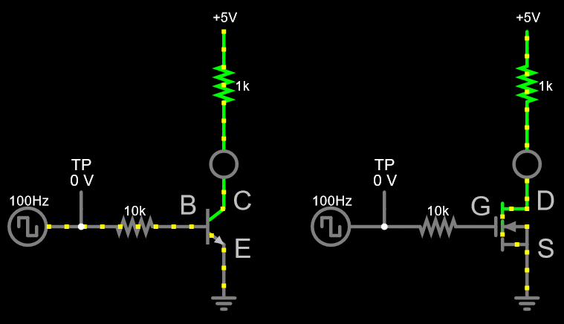
Two major types of transistors Current controlled & Voltage controlled
Falstad link

Slide 4
But, voltage drive can be converted into current drive
The resistor effectively changes a voltage drive to a current drive

Slide 5
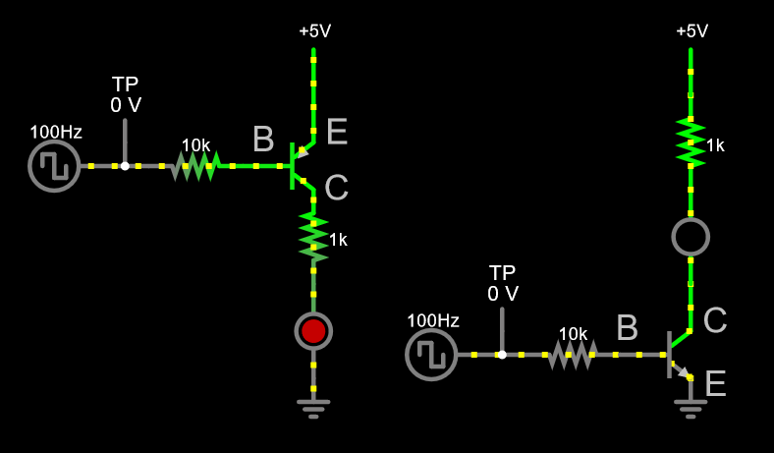
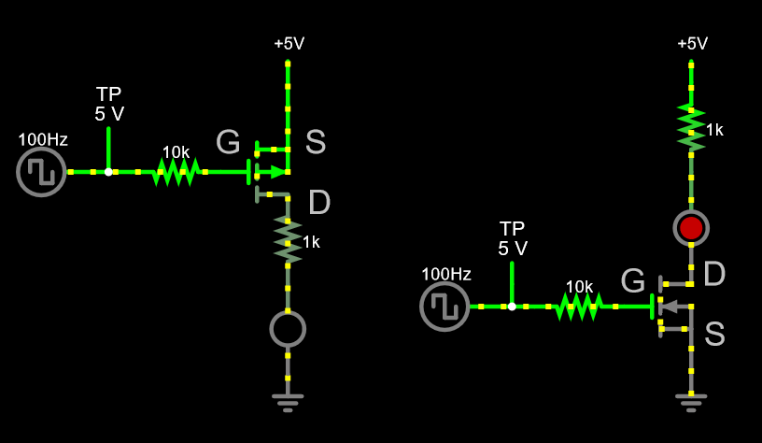
Each major type has complementary versions
Falstad link
Falstad link
n-type is low side
p-type is high side

Slide 6
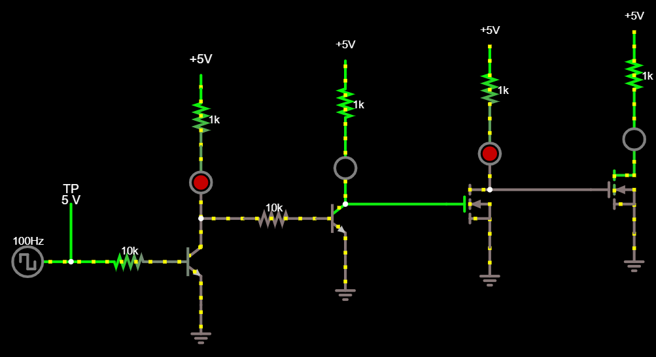
“Common Emitter/Source” Inverts

Slide 7
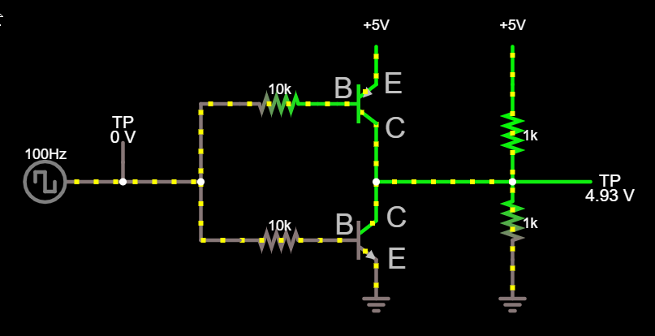
Complementary Bipolar Output
Falstad link

Slide 8
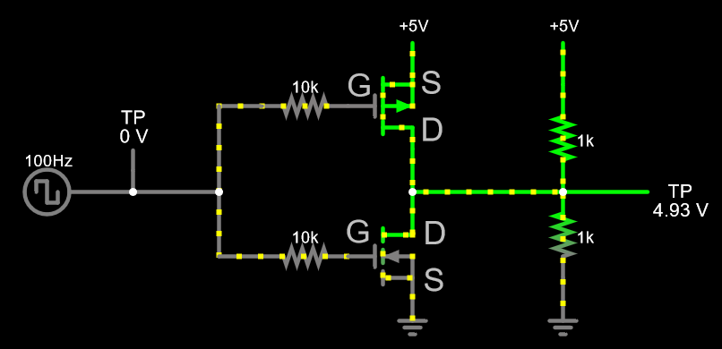
Complementary MOSFET Output
Falstad link

Slide 9
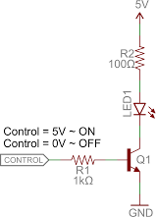
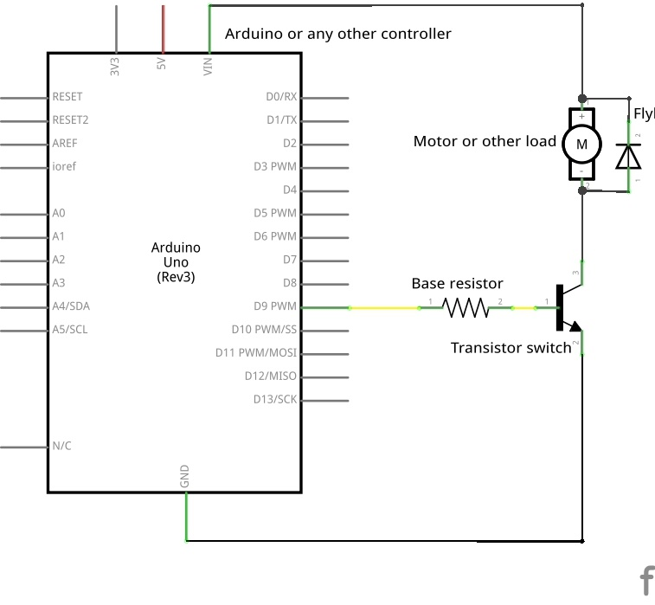
BJT Motor or LED Driver Example
Why is a transistor used here?

Slide 10
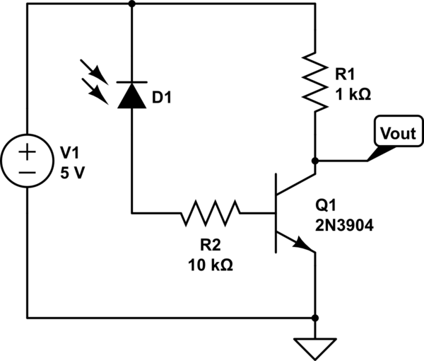
BJT Photodiode Example
Why is a transistor used here?

Slide 11
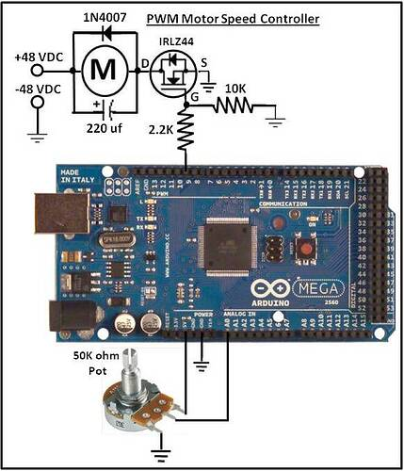
High voltage motor control
Why is a transistor used here?

Slide 12
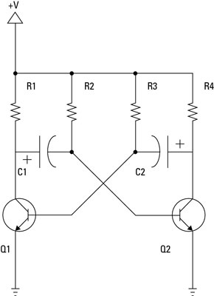
Two transistor oscillator

Slide 13
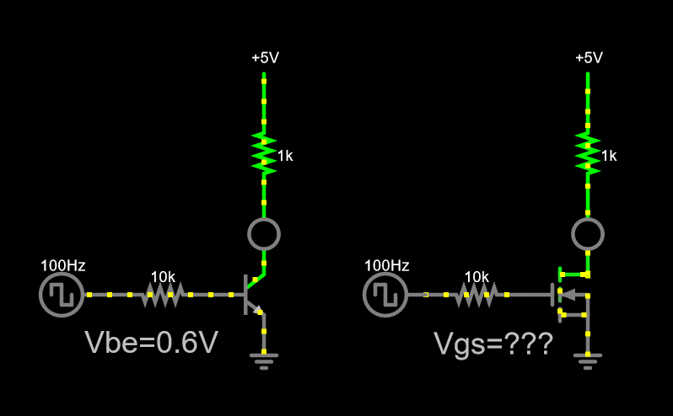
If they’re the same, why choose one over the other?
BJTs are generally easier to select and use
but… not always

Slide 14
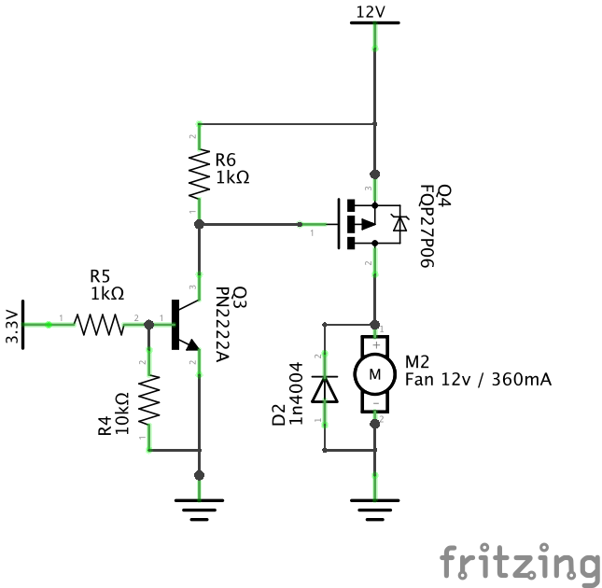
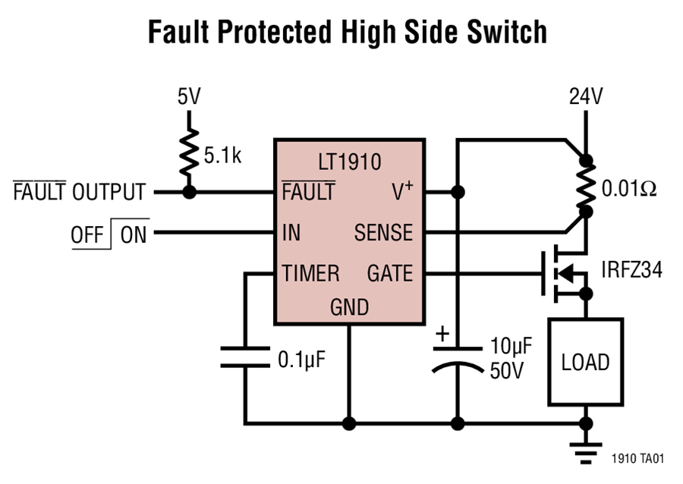
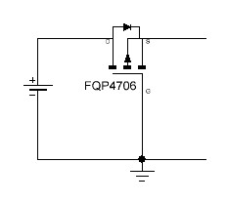
MOSFET Examples
Note the “body diode” which is intrinsic to all MOSFETs

Slide 15
MOSFET, Body Diode Can be Useful
Normal operation is through body diode.
During reverse polarity, FET is off and diode blocks current flow

Slide 16
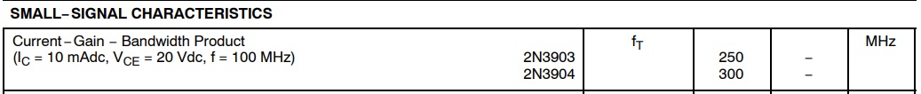
Key Bipolar Transistor Specs
Collector-emitter Breakdown Voltage
Maximum operating C-E should be 20-50% lower
Maximum continuous collector current
You should be below this with some margin ~20%
f_{T} – frequency at which gain falls to 1
Should be > 100x your operating frequency
Avoid super high frequency transistors (1GHz!)

Slide 17
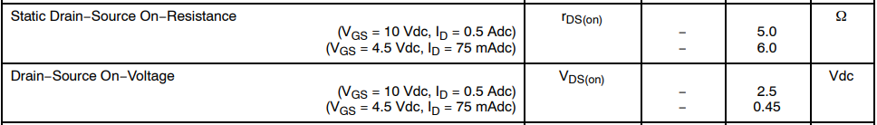
Key MOSFET Specs
Drain-Source Breakdown Voltage
Maximum operating D-S should be 20-50% lower
Gate threshold voltage
You should be well above/below this
On-Voltage (or On-Resistance)
Should be low enough

Slide 18
MOSFET vs Bipolar Pros/Cons
Bipolar
Easier to drive voltage-wise
Rugged
MOSFET
Can be more efficient
Can switch faster
Gate easier to drive current-wise
Poor selection for 3.3V circuits
Can be difficult to select proper Vt
Very application dependent:
Switching power supplies
Audio Amplifiers
GPIO LED bias
Practical guidance/tendencies:
Low power, low voltage -> bipolar
High current -> FET
High efficiency switching supplies -> FET

Slide 19

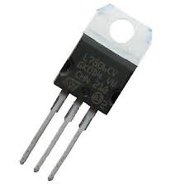
Go-to Transistors
Bipolar – the workhorse for enthusiasts
2N3904 – NPN, 40V, 200mA, 300MHz f_{T}
2N3906 – PNP, -40V. 200mA, 250MHz f_{T}
TIP120 – NPN, 60V, 5A
MOSFETs
Probably don’t want to stock FETs
Wanna play? 2N7000, 2N7002 - NMOS

Slide 20
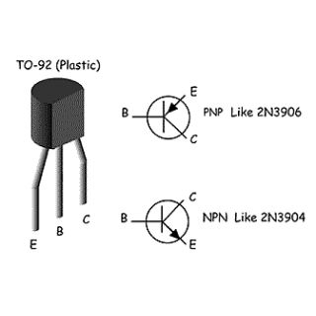
Common Bipolar Pinouts

Slide 21
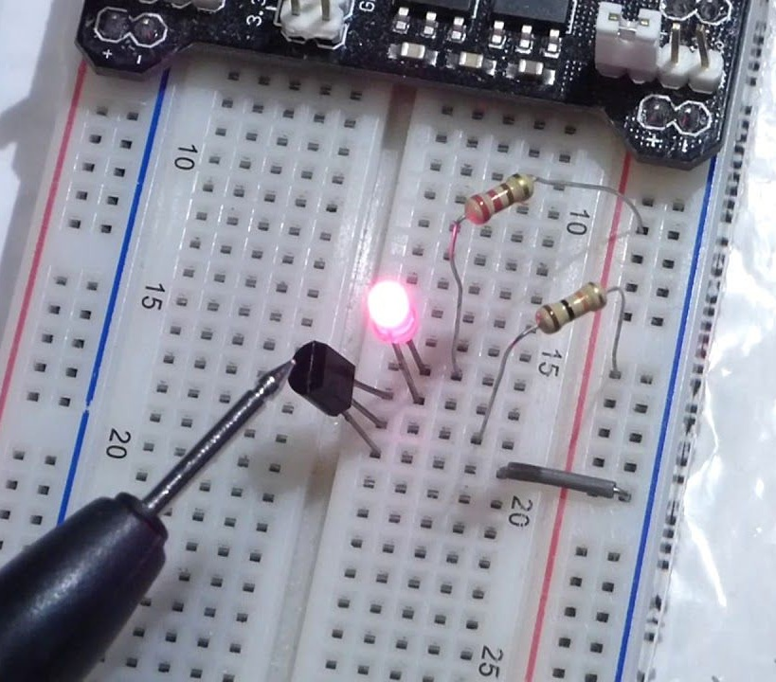
Typical Breadboard Application

Slide 22
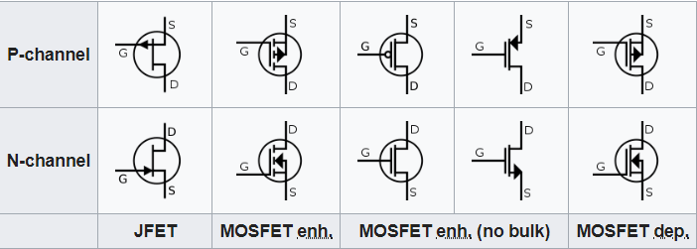
MOSFET Schematic Symbols
There are many, many variations on these
FETs of the same type (P vs N) behave similar to each other
Be aware but don’t fret over it too much

Slide 23

Transistors as Amplifiers

Slide 24
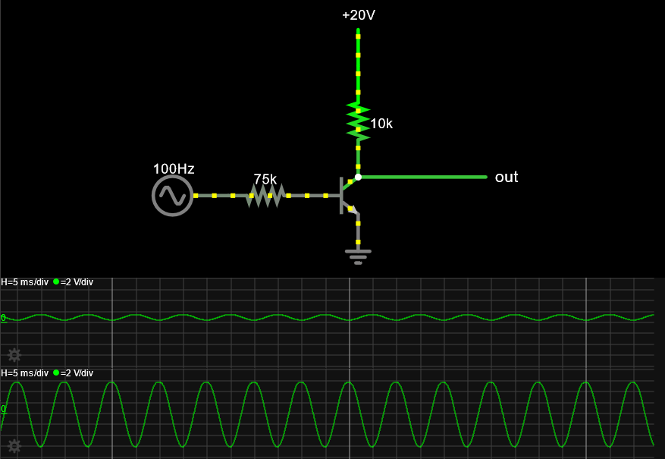
A Linear Amplifier
Falstad Simulation

Slide 25
Not a good design
Falstad Simulation
Problems
Gain will vary too much with β (h_{fe}) variation
Linearity isn’t very good
Input dynamic range is poor
Circuit needs fine-tuning per transistor used

Slide 26
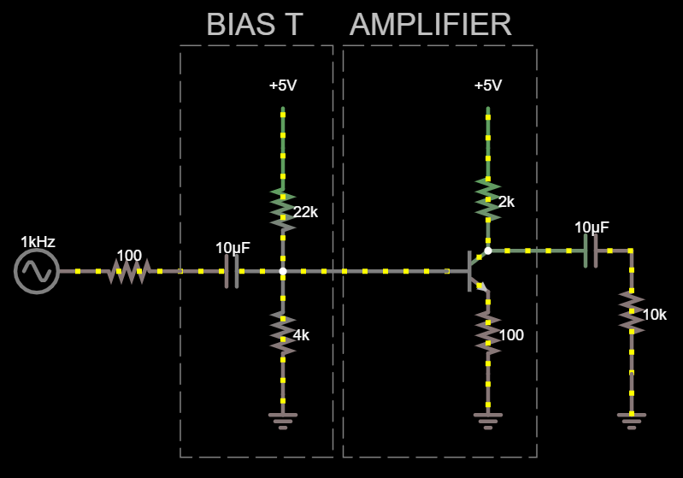
A Better Design
Gain ~= -Rc/Re
Improved distortion
Improved dynamic range
Less sensitive to individual transistor characteristics

Slide 27
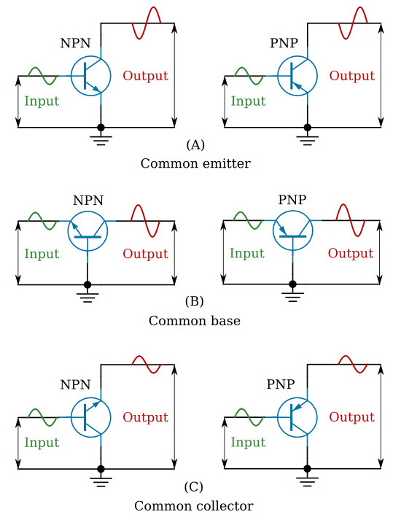
Common Configurations
V and I gain
Low input R
Low output R
V gain
Low input R
High output R
I gain
High input R
Low output R

Slide 28
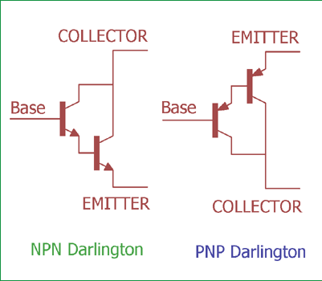
Darlington Pair
Gain is squared (100 becomes 10,000)

Slide 29
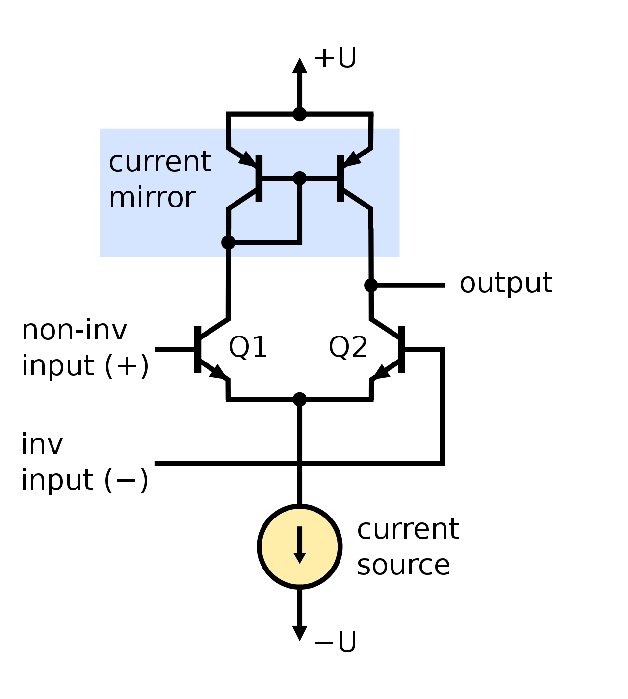
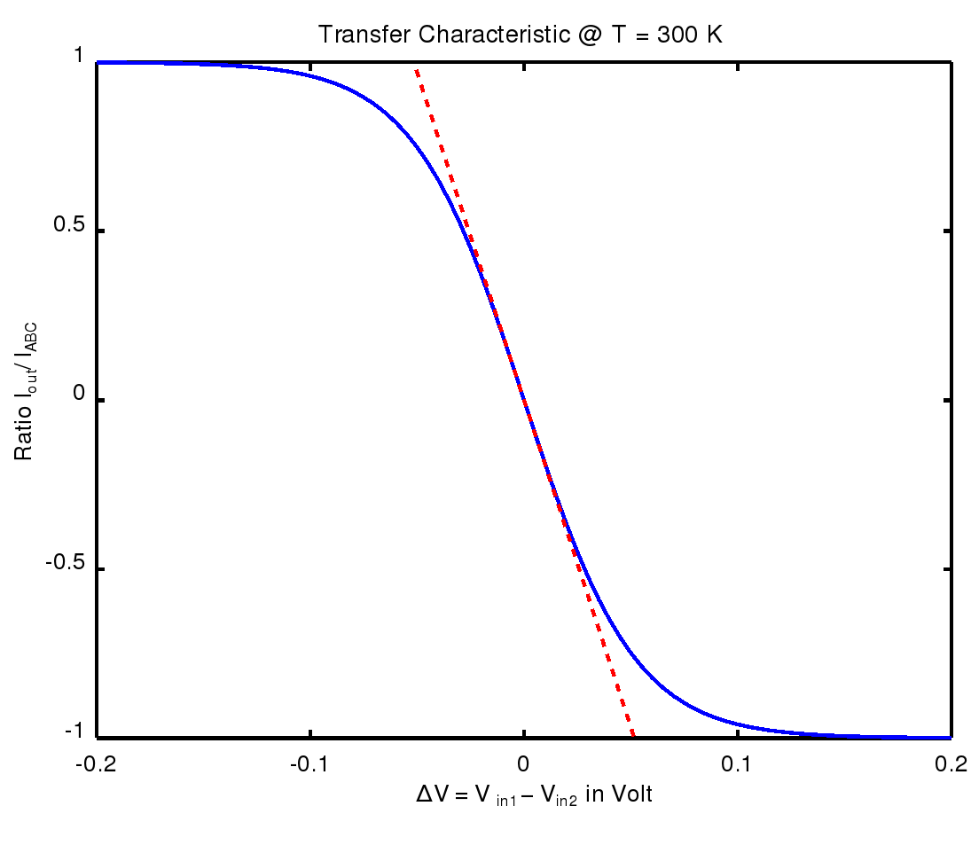
Differential Pair

Slide 30
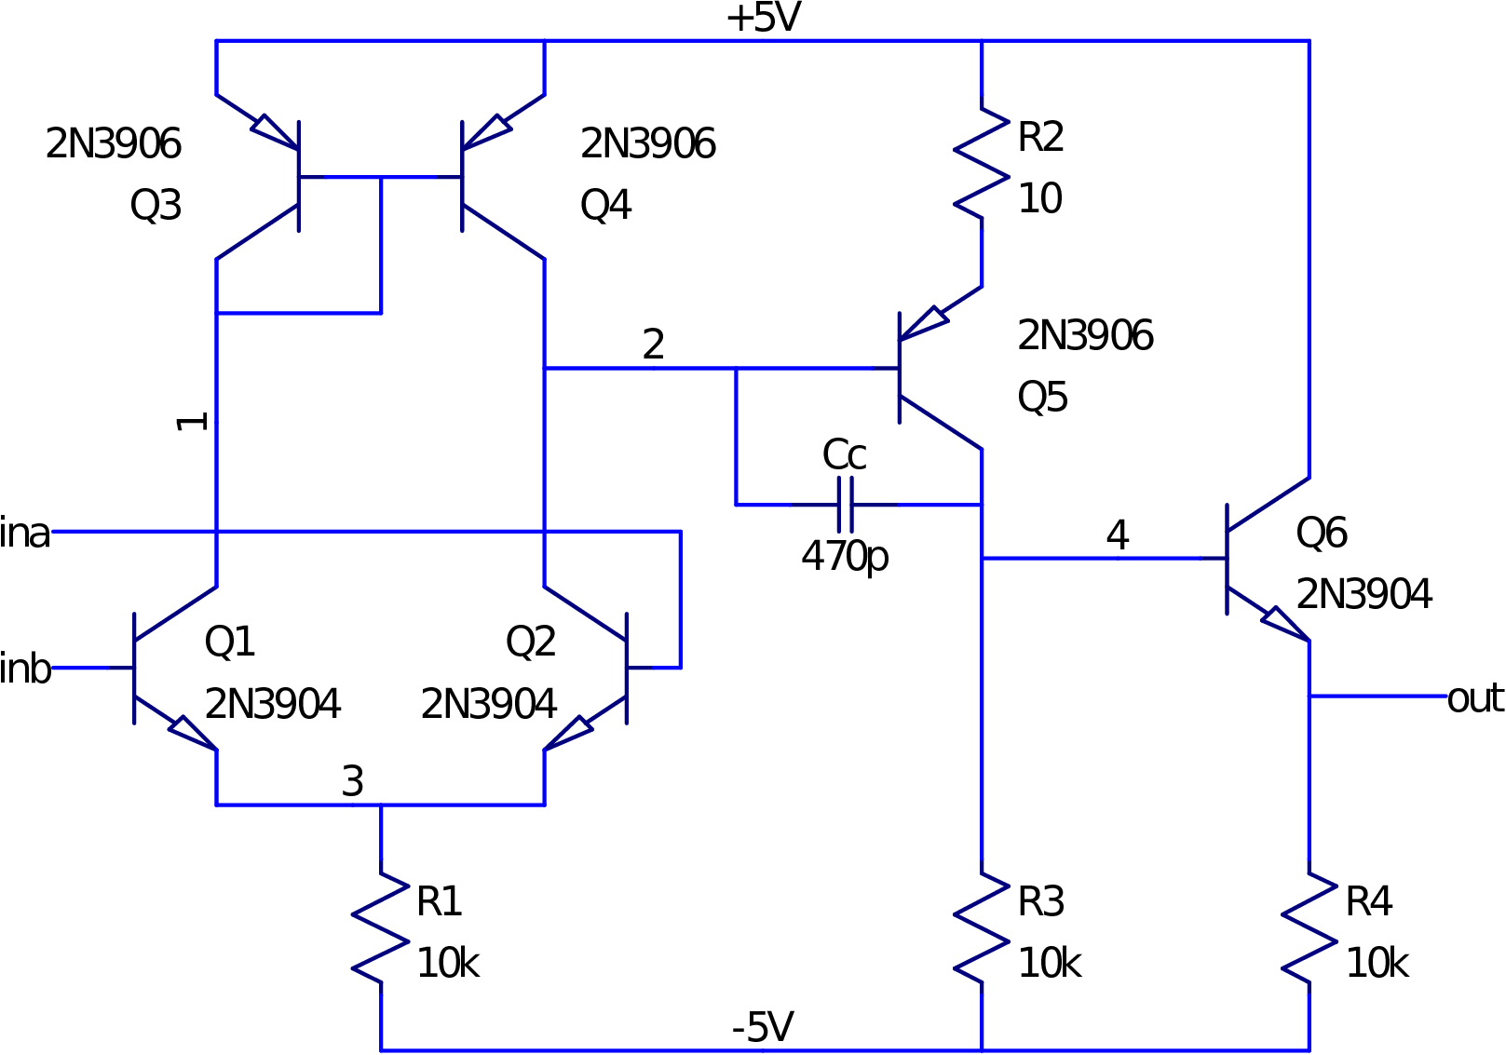
Simple Op-Amp

Slide 31
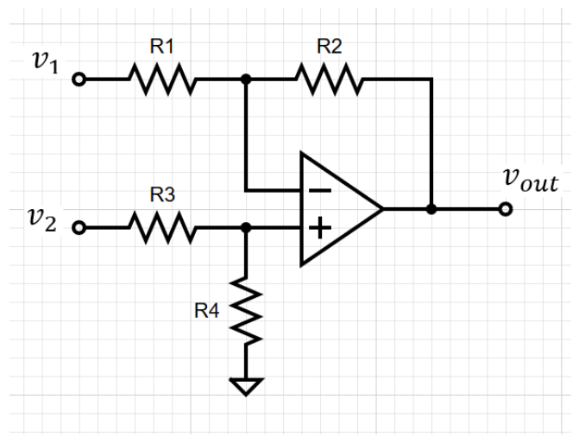
Simple Op-Amp Usage
Simple circuit
Near ideal performance

